Slide 1
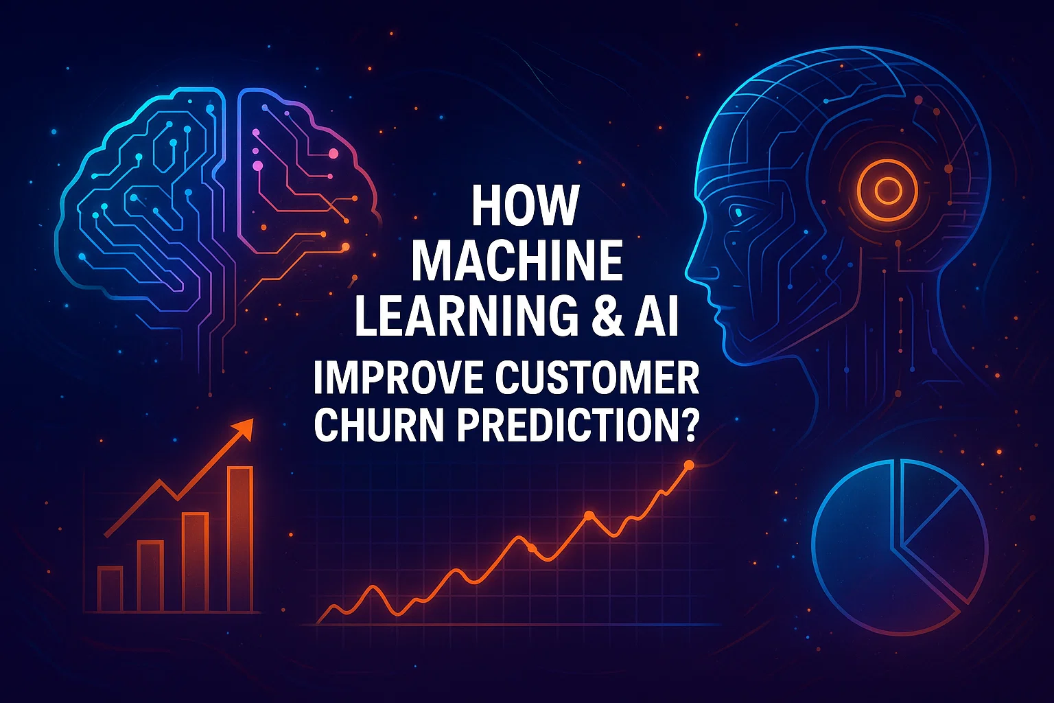
Customer Churn Prediction System
Machine Learning Internship – Task 2 (Future Interns)
NAME: M VADIVAMBAL
ROLE: MACHINE LEARNING INTERN
ORGANIZATION: FUTURE INTERNS
TOOLS USED: PYTHON| PANDAS|NUMPY|MATPLOTLIB
|GOOGLE COLAB

Slide 2
Problem Statement
One of the main issues that telecommunication, banking, internet services, and OTT platforms companies face is customer churn, as they all relied on subscription-based business models. The cost of retaining a customer is less than the cost of gaining a new one. The use of Machine Learning for customer churn prediction in this project will enable the company to perform aimed customer analysis and to know who is considering leaving service. This analysis can give birth to marketing strategies like lowering prices, increasing service quality, and improving customer satisfaction.
Key Purpose:
To detect customers who are likely to stop using the service
To help businesses reduce revenue loss by retaining customers
To support data-driven decision-making using machine learning

Slide 3
Dataset Description
This dataset contains customer details, service usage patterns, and billing information, which helps in predicting whether a customer will churn or remain with the company.
Dataset Used: Telco Customer Churn Dataset
Total Records: 7043 customers
Type: Real-world telecom customer data
Customer Information: gender, SeniorCitizen, Partner, Dependents
Account Details: tenure, Contract type, Payment method
Service Details: Internet service, Online security, Streaming services
Charges: Monthly Charges, Total Charges
Target Column: Churn (Yes / No)

Slide 4
Data Preprocessing & Cleaning
To prepare data for modeling, the following pre-processing steps/measures were applied:
Handled Missing Values Checked dataset for null / blank values Cleaned invalid or empty TotalCharges values
Converted Categorical Data to Numerical Used encoding to convert Yes/No and category columns into numeric format Prepared data for machine learning algorithms
Removed Unnecessary Columns Dropped Customer IDs and irrelevant columns that don’t affect prediction
Feature Scaling Scaled numerical values like tenure, MonthlyCharges, TotalCharges for better model performance
Data preprocessing sought to increase data accuracy by creating clean, clear, and machine-readable data which would thereby enhance the capacity of the churn predictive model.

Slide 5
Model Building
To predict customer churn, multiple machine learning models were trained and tested: Train–Test Split Dataset was divided into training data (80%) and testing data (20%).
Models Used Logistic Regression – baseline classification model Random Forest Classifier – ensemble model for better accuracy
Training Models were trained using customer features Target variable: Churn (Yes / No)
Prediction Models predicted whether a customer will churn and provided churn probability

Slide 6
Model Evaluation & Performance
To measure how well the churn prediction model performed, different evaluation metrics were used:
Accuracy Measures how many overall predictions were correct
Precision Measures how correctly the model identified real churn customers
Recall Measures how many actual churn customers were successfully detected Very important in churn prediction because missing a churn customer is costly
Confusion Matrix Shows correct vs incorrect predictions Helps understand True Positives, False Positives, True Negatives, False Negatives
ROC – AUC Score Evaluates how well the model distinguishes churn vs non-churn customers

Slide 7
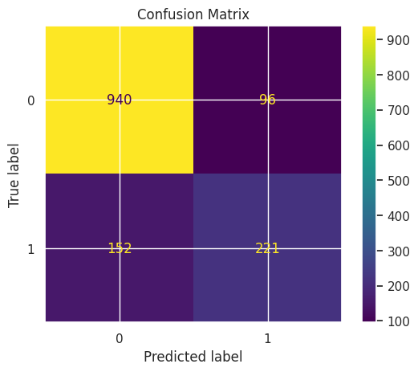
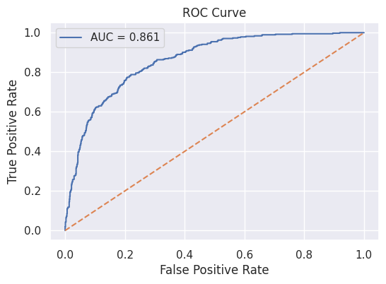

Slide 8
Key Insights & Observations
Based on data analysis, visualizations, and model results, the following churn insights were identified:
Customers with Short Tenure churn more New customers (less than few months) are more likely to leave
Higher Monthly Charges increase churn Customers paying high bills tend to discontinue services
Contract Type has a strong impact Month-to-month contract users churn more1-Year / 2-Year contract users are more stable
Lack of Additional Services leads to churn Customers without security/backup/extra services tend to leave
Senior Citizens show slightly higher churn rate Need better support / value plans

Slide 9
Business Impact & Recommendations
Target High-Risk Customers
Use churn probability scores to identify customers likely to leave
Send personalized offers, discounts, or loyalty rewards
Improve Retention for Month-to-Month Users
Encourage customers to switch to 1-year or 2-year contracts
Provide incentives for long-term plans
Reduce High Monthly Charges
Provide flexible pricing plans
Introduce bundled packages to reduce bill pressure
Enhance Customer Support
Focus on senior citizens and new customers
Proactively resolve complaints to prevent churn
Service Improvement
Offer additional services like security, backup, and support plans

Slide 10
Churn Prediction System – Final Output
This project successfully developed a Machine Learning–based Customer Churn Prediction System capable of:
Predicting whether a customer will churn or stay
Providing churn probability score
Identifying key factors influencing churn
Supporting business teams with data-driven decisions
Outputs Generated:
Confusion Matrix
Accuracy, Precision, Recall
ROC-AUC Curve
Feature Importance / Key Drivers
Visual Insights (Tenure vs Churn, Contract vs Churn, Charges vs Churn)

Slide 11
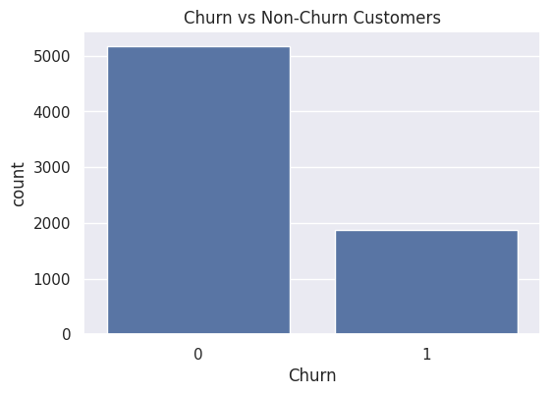
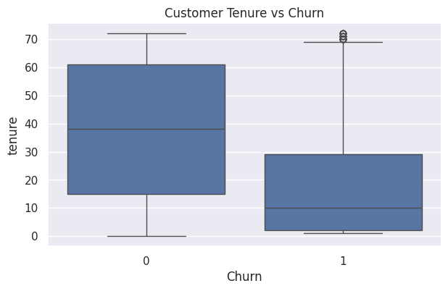

Slide 12
Conclusion
The AI implementation shows that Churn can be predicted through Machine Learning with good accuracy which translates into the customers' lives through retention, revenue saving, and service quality enhancement.
Successfully built a Customer Churn Prediction System using Machine Learning
Applied data preprocessing, feature engineering, and model training on Telco Churn dataset
Evaluated model performance using Accuracy, Precision, Recall, Confusion Matrix & ROC-AUC
Identified key churn factors such as tenure, contract type, and monthly charges
System helps businesses predict at-risk customers early and reduce churn
Supports data-driven decision-making for improving customer retention strategies

